Slide 1

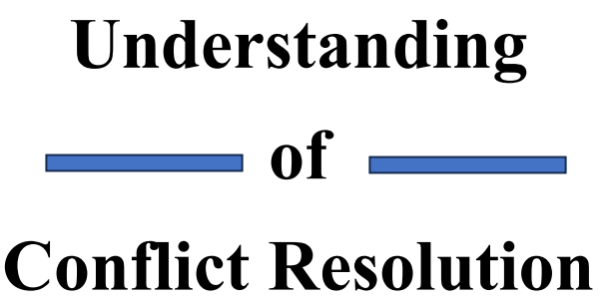

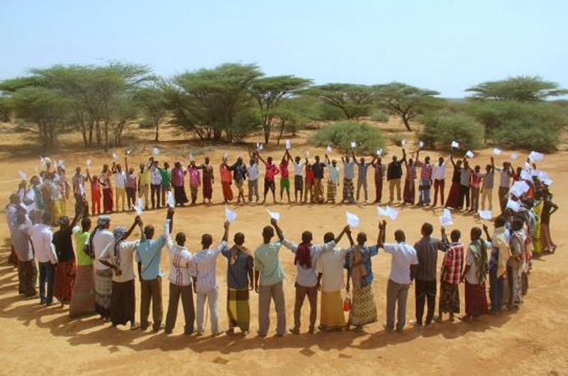
Chapter Five: INTRODUCTION OF PEACE

Slide 2
What is peace (Nabad)?
Peace is defined as societal harmony and mutual respect.
In the absence of animosity and violence, In social contexts, the absence of conflict (like war) and the absence of fear of violence among the people or groups are usually understood to constitute peace.
It has been argued by some that inner qualities such as tranquility, patience, respect, compassion, kindness, self-control, courage, moderation, forgiveness, equanimity, and the ability to see the big picture can promote peace within an individual, regardless of the external circumstances of their life.
Peace should be founded on fairness within and between societies, the protection of basic individual and group rights, and the avoidance of the use of violence to settle conflict.

Slide 3
The Origin of the Word “Peace”
Historically the word "peace." Originating from the Latin pax, the Anglo-French phrase pes means "peace, compact, agreement, treaty of peace, tranquility, absence of hostility, harmony."
In many languages, the word 'peace' is also used as a greeting or a farewell, for example, the Hawaiian word aloha, as well as the Arabic word salaam.
In English, the word peace is occasionally used as a farewell, especially for the dead, as in the phrases "rest in peace" or "peace out"

Slide 4
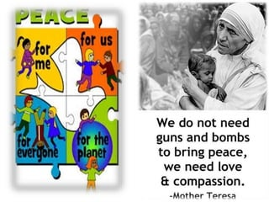
,

Slide 5
Components of Peace
We define peace through the following four components:
Peace is an outcome: it is assessed by the absence or cessation of violence.
Peace is a process: peace-building is characterized by efforts to negotiate freedom from violence through the creation of social bonds within and across groups of people.
Peace is a human disposition: it is a personal and social orientation to secure freedom from distress and to foster a capacity to act, predicated on a fundamental recognition of freedom and dignity of all people
Peace is a culture: it is distinctive from a culture of violence, and fosters a sense of global citizenship.

Slide 6
What are the components of peace and its foundation?
they are: virtue, justice, order, good law, good government, good relationship, well-being, freedom, respect for human rights, security etc., or an absence of violence.
And there are also eight pillars of peace which should be addressed simultaneously, as much as possible:
1) a well-functioning government 2)a sound business environment;3)an equitable distribution of resources. 4)an acceptance of the rights of others; 5)good relations with neighbors 6)free flow of information 7) a high level of human capital; 8) low level of corruption.

Slide 7
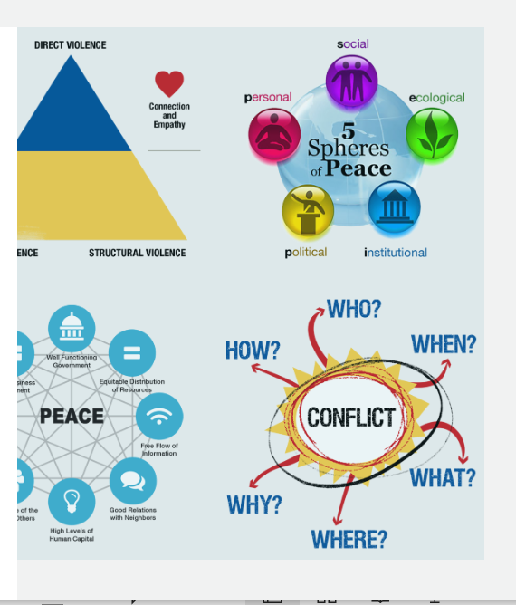

Slide 8
Types of Peace
Peace is classified into four types:
Positive peace: Positive peace refers to the absence of indirect and structural violence. It is a more lasting peace, is built on sustainable investments in economic development and institutions as well as the societal attitudes that foster peace.
Negative peace: it is defined by the absence of war and violence.

Slide 9
Types of Peace
Internal peace: it is is "peace of mind or soul.“, the absence of afflictions or mental disturbances, such as worry, anxiety, greed, hatred, delusion, leads to a state of peace, serenity, and tranquility of mind.
External peace. A condition of peaceful and contented coexistence between humans and the natural world is known as external peace, and it is a state that exists in society, nations, and the entire planet.

Slide 10
Level of peace
Personal Peace: is the state of accepting oneself for who you are—spirit, soul, and body—regardless of how you look to the outside world or how you perceive yourself.
Interpersonal Peace: The achievement of peace between individuals and groups requires the development of negotiation and conflict resolution techniques that increase interpersonal empathy and prevent violence.
Societal Peace: In social contexts, the absence of conflict (like war) and the absence of fear of violence amongst people or groups are usually understood to constitute peace
Global Peace: it is the idea of a perfect state of harmony amongst all people and nations on earth is known as "world peace."

Slide 11
Types of Violence
Cultural Violence
Cultural violence is viewed as a wellspring of other sorts of violence since it fosters hatred, fear, and distrust.
Religion and ideology may all be identified as potential causes of cultural violence since they impact "the symbolic sphere of our existence“
These symbols or events have also been used to construct barriers to discriminate against those who do not share them in various countries.

Slide 12
Types of Violence
Direct Violence
Direct violence, as it is often understood, refers to physical damage and the inflicting of pain caused by a single individual.
Structural Violence
The lack of educational possibilities, free expression, and freedom of association reduces the quality of life.
These factors are related to unequal life chances, unequal resource distribution, and unequal decision-making authority.
So, structural violence occurs when a group is disproportionally disadvantaged or harmed by institutions, laws, or other general structures of society.

Slide 13
Approaches of Peace
1. Peace Making
Peacemaking refers to the process of resolving conflicts and fostering reconciliation between individuals, groups, or nations.
Key elements of peace-making include:
Dialogue and Communication
Negotiation
Conflict Resolution
Mediation
Reconciliation
International Diplomacy
Community Involvement
Post-Conflict Reconstruction

Slide 14
Approaches of Peace
2. Peace Keeping
Peacekeeping refers to the deployment of international forces to help maintain or restore peace in areas affected by conflict.
Key characteristics of peacekeeping missions include:
Impartiality
Consent of Parties
Multinational Composition
Conflict Prevention and
Management
Disarmament, Demobilization, and Reintegration (DDR)
Humanitarian Assistance
Rule of Law and Institution Building
Political Process Support

Slide 15
Approaches of Peace
3. Peace Building
Peacebuilding is the long-term process of fostering communication, mending relationships, and institutional transformation.
Whether the conflict is between societies, within communities, or between the state and common people, finding solutions and addressing the root causes of conflict are essential to ending violence.
Peacebuilding takes place either before violent conflict erupts or after violent conflict ends.

Slide 16
History of Peacebuilding
As World War II ended in the mid-1940s, international initiatives such as the establishment of the Bretton Woods institutions and The Marshall Plan consisted of long-term post-conflict intervention programs in Europe through which the United States and its allies aimed to rebuild the continent following World War II's destruction.
Johan Galtung, a Norwegian sociologist, created the term "peacebuilding" in 1975.
Peacebuilding has since expanded to include many different dimensions, such as disarmament, demobilization and reintegration, and rebuilding governmental, economic, and civil society institutions

Slide 17
Elements of Peace Building
The components of peace-building might change based on the unique requirements and environment of a particular circumstance.
The following are some typical components:
Issue resolution
Security sector reform
Institution-building
Economic and social development
Human rights and the rule of law
Government and democracy
Gender mainstreaming
Trauma healing and reconciliation

Slide 18
Importance of Peace Building
Peace building is important because of the following reasons:
Resolving the underlying political
Encouraging stability and security
Promoting economic growth
Improving democratic governance
Promoting the rule of law and human rights
Promoting women's involvement in peace-building initiatives
Healing and reconciliation

Slide 19
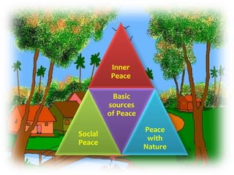
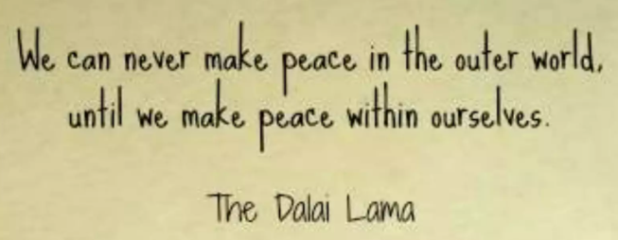


Slide 20
Sample of MCQ on Peace and Conflict Studies: Nature and Scope with answers
1. What is the primary focus of peace and conflict studies?
a) Analyzing historical wars
b) Exploring the causes of peace
c) Examining the dynamics of violent conflict
d) Promoting military interventions
Answer: c) Examining the dynamics of violent conflict
2. Which of the following is NOT a characteristic of peace as studied in peace and conflict studies?
a) Absence of violence b) Social justice
c) Economic inequality d)Respect for human rights
Answer: c) Economic inequality

Slide 21
3. Which discipline heavily influences peace and conflict studies?
a) Engineering b) Sociology c)Astronomy d)Agriculture
Answer: b) Sociology
4. What does the term "conflict resolution" refer to in the context of peace and conflict studies?
a) Escalating conflicts to achieve a resolution
b) Managing conflicts to maintain stability
c) Peaceful resolution of disputes and tensions
d) Intervening militarily to end conflicts
Answer: c) Peaceful resolution of disputes and tension
5. Which approach emphasizes addressing the root causes of conflicts in peace and conflict studies?
a) Reactive approach b) Proactive approach
c) Structural approach d) Militaristic approach
Answer: c) Structural approach

Slide 22
6. Peacebuilding involves which of the following activities?
a) Promoting arms races b)Supporting reconciliation efforts
c) Encouraging violent protests d) Ignoring human rights violations
Answer: b) Supporting reconciliation efforts
7. Which of the following is NOT a level of analysis commonly used in peace and conflict studies?
a) Micro-level b)Macro-level c) Meso-level d) Nano-level
Answer: d) Nano-level
8. According to peace and conflict studies, what are some root causes of conflicts?
a) Economic disparities b)Global warming
c) International cooperation d)Religious harmony
Answer: a) Economic disparities
9. Which of the following is a major goal of peace and conflict studies?
a) Fostering violent extremism b) Promoting war strategies
c) Building sustainable peace d) Advancing authoritarian regimes
Answer: c) Building sustainable peace

Slide 23
10. What role does diplomacy play in peace and conflict studies?
a) Aggravating conflicts b) Ignoring diplomatic solutions
c) Resolving disputes through negotiation d) Increasing military tensions
Answer: c) Resolving disputes through negotiation
11. In peace and conflict studies, what is meant by "negative peace"?
a) Complete absence of conflict b)Temporary cessation of violence
c) Superpower dominance d)Armed resistance movements
Answer: b) Temporary cessation of violence
12. Which of the following is an example of a non-state actor in the context of peace and conflict studies?
a) United Nations b)NATO
c) Greenpeace d)European Union
Answer: c) Greenpeace

Slide 24
13. What role do human rights play in peace and conflict studies?
a) Promoting inequality b)Protecting the rights of individuals
c) Ignoring civil liberties d) Advocating for authoritarianism
Answer: b) Protecting the rights of individual
14. Which of the following is a method used in peace and conflict studies to prevent violence?
a) Arming conflicting parties b) Encouraging hate speech
c) Promoting dialogue and negotiation d) Supporting ethnic cleansing
Answer: c) Promoting dialogue and negotiation
15. According to peace and conflict studies, what is the role of gender in conflict resolution?
a) Exacerbating tensions b)Marginalizing women's voices
c) Promoting inclusivity and empathy d)Encouraging patriarchal dominance
Answer: c) Promoting inclusivity and empathy

